Slide 1

Population in tamil nadu
Final Assignment

Slide 2
Introduction / Business Problem
This project is divided into 3 phases :
Identifying the city with the highest population
Create a model to predict the population in this particular city
Use Foursquare location data to search for a few places in this city

Slide 3
Target Audience
These parameters are most vital when determining the population of a particular place.
This project will be helpful in approximating the census of a particular place. Census takes places every 10 years in India. The next census is due to take place next year(in the year 2021).
The government and the people involved in determining the census will benefit from this project.

Slide 4
Data used
Population of different districts in Tamil Nadu according to the latest census.
Latitude and Longitude of Tamil Nadu(used for mapping)
Population in the Chennai district for the past Century(1911-2011)
Birth Rates, Death Rates and Migration-in data for Chennai from 1911-2011
Foursquare location data to search for places in Chennai.

Slide 5
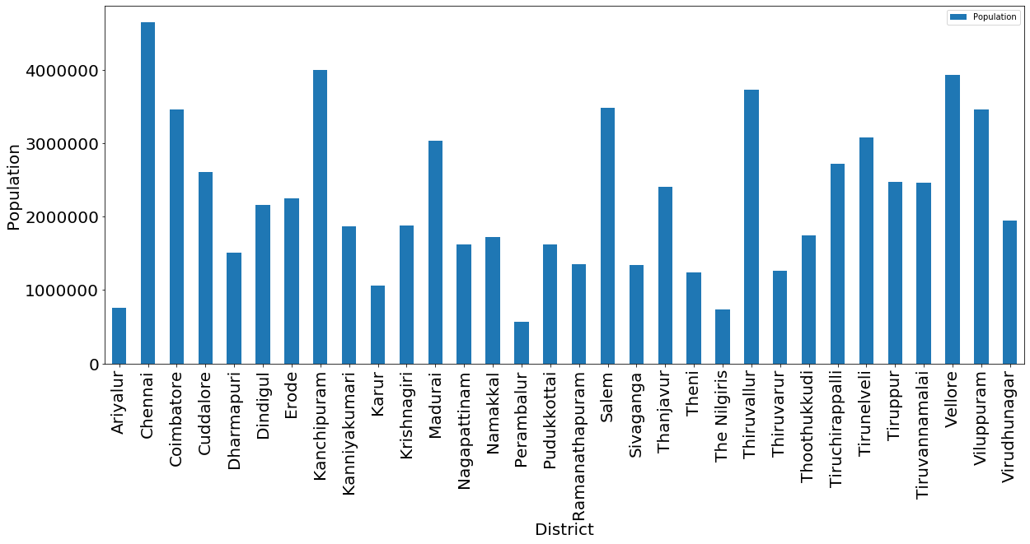
Identifying the city with the highest population
We can see that the ‘Chennai’ has the highest population.

Slide 6
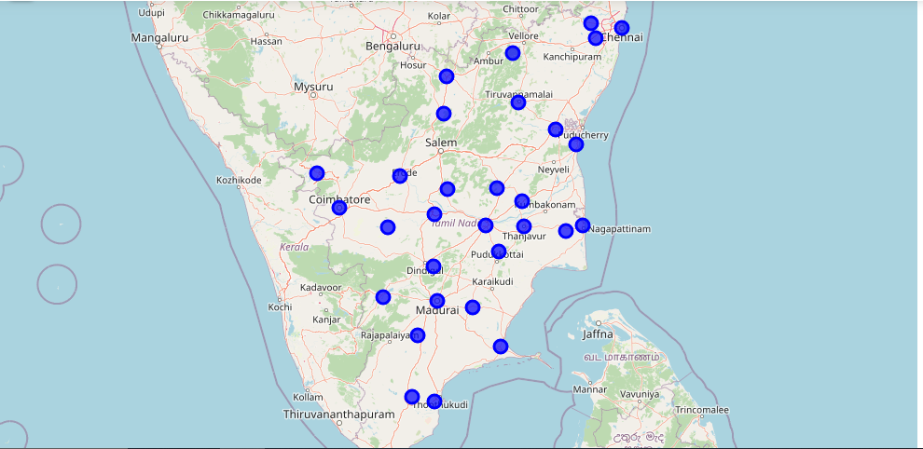
Map of Tamil Nadu

Slide 7
Model Prediction
Firstly split the whole dataset into train and test datasets.
‘Birth Rate’, ‘Death Rate’ and ‘Migration into Chennai’ are the values of x.
‘Population’ is the y value.
Fit the training data using multiple regression. Predict the data using the testing data(x_test).
Find the accuracy score using variance(regr.score). The variance is found to be 0.70.

Slide 8
Equation of the Model
6336312.63772044-43774.97211650234x-113134.85515103952y-2.533565277148994z
x= Birth Rate
y=Death Rate
z=Migration into Chennai

Slide 9
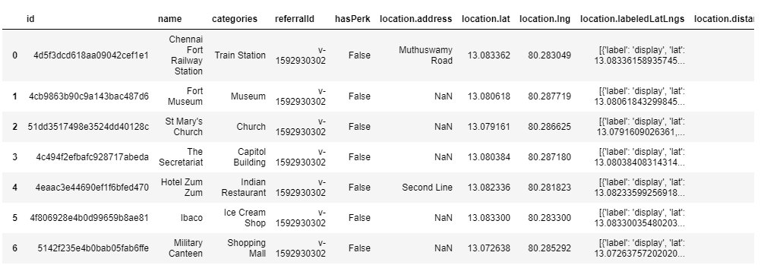
Foursquare Location Data
Using the foursquare location data, we can view a few places in Chennai along with their categories and location data.

Slide 10
Results
Most populous district in Tamil Nadu: Chennai.
Variance of the multiple linear regression model is 0.70.
R2 score is found to be 0.42.
We were able to view 30 places in Chennai along with its category and location data.

Slide 11
Discussions
The variance of the model is decent enough but the R2 score value is slightly less.
The model can be enhanced further to make sure that the R2 score is better.
Having more parameters for evaluation such as number of people migrating out of Chennai can help make a better model.

Slide 12
Conclusion
In this project, the most populated district in Tamil Nadu has been evaluated using a bar plot and is found to be ‘Chennai’.
Equation of the model : 6336312.63772044-43774.97211650234x-113134.85515103952y-2.533565277148994z
x= Birth Rate
y=Death Rate
z=Migration into Chennai
The Foursquare Location data was used to check out a few places in Chennai.

